Slide 1
E-learning
WP 2
„Innovative IPM solutions for winter wheat based rotations”
Crop diversification

Slide 2
Crop diversification
Crop diversified systems show much in common with sustainable and agroecological management approaches and outcomes in agricultural practices. Diversification across temporal scales serves as the mechanism for maintaining and regenerating the biotic interactions in the ecosystem — e.g., biodiversity, soil quality, nutrient management, water-holding capacity, control of weeds, diseases, and pests, pest resistance and resilience to climate change and crop productivity.
Increasingly diversified cropping systems have been replaced with highly simplified industrial monocultures. Average field and farm sizes have increased, which leading to higher levels of homogeneity at both the field and landscape scales. The simplification of agroecosystems has led to a loss of biodiversity and to enhance pests competition or crop infection by pathogens.

Slide 3
Zróżnicowanie upraw
Zróżnicowanie upraw w płodozmianie jest ważnym elementem zrównoważonego rolnictwa i odznacza się trwałym wpływem na agroekologiczne zasady uprawy i ochrony roślin rolniczych. Dywersyfikacja upraw w przestrzeni czasowej jest istotnym mechanizmem utrzymania i zarządzenia biotycznymi interakcjami w ekosystemie - np, różnorodności biologicznej, jakości i zasobności gleb, zarządzania dostępnością składników odżywczych, zasobnością w wodę, ograniczaniem występowania chwastów, chorób i szkodników, czy wpływem na zjawisko uoodporniania się agrofagów, reakcją na zmiany klimatyczne czy też w efekcie końcowym na plonowaniem roślin uprawnych.
Coraz częściej zróżnicowanie w strukturze zasiewów zostaje zastąpione uproszczoną rotacją upraw, często w oparciu o dominację monokultur (np. zbożowych). Średnia wielkość farm i pól wzrasta, co prowadzi do ograniczania bioróżnorodności, zarówno w skali pola jak i krajobrazu rolniczego. Uproszczenie agroekosystemów rolniczych doprowadziło do utraty różnorodności biologicznej i wzrostu konkurencyjności ze strony agrofagów (np. kompensacja chwastów), a także zwiększonego ryzyka pojawienia się szkodników czy też patogenów chorobotwórczych.

Slide 4
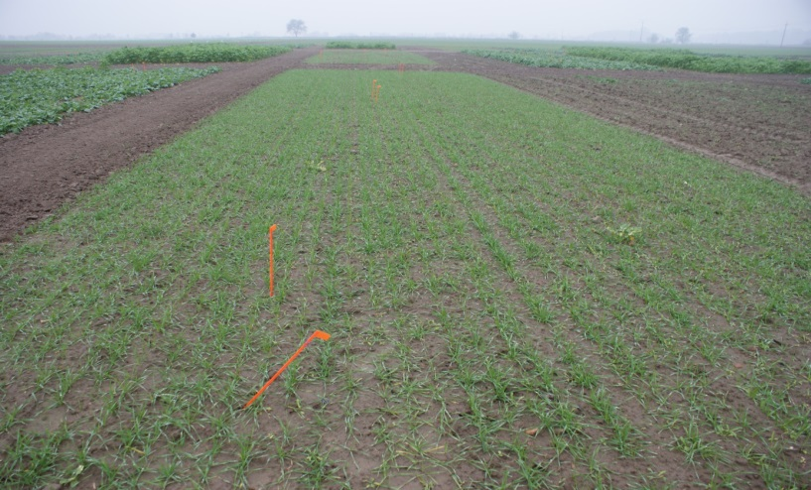
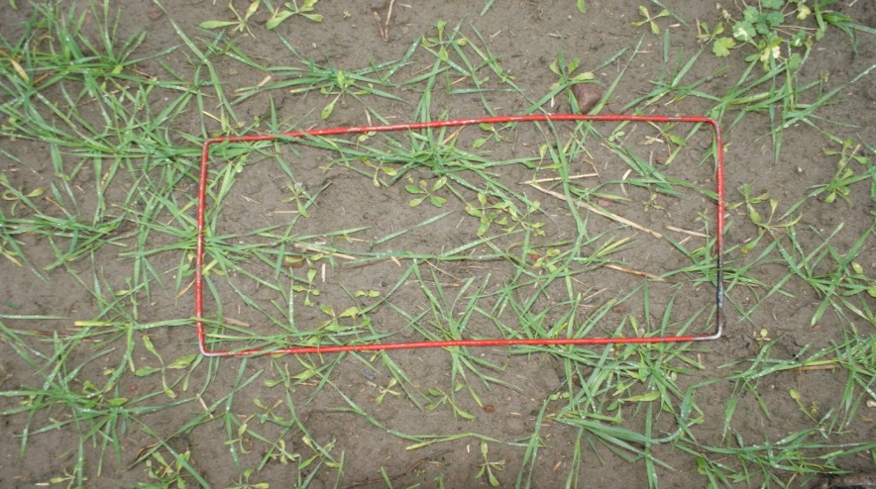
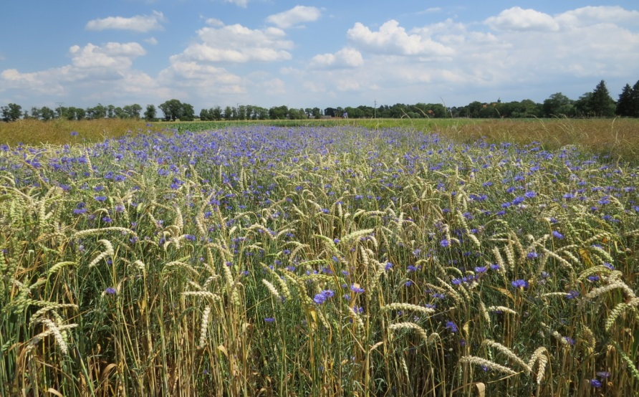
Crop diversification - effect on weeds
Winter wheat in monoculture
Winter wheat in monoculture (CS) in autumn (standard time od sowing - III decade of September) – single variety
Weed infestation of winter wheat (monoculture- CS)
Continuous monocropping can produce highly dense, locally adapted populations of single weed species that compete strongly with the crop.
Winter wheat in conventional system (CS) - monoculture (high infestation by cornflower)- I decade of July (one variety)

Slide 5
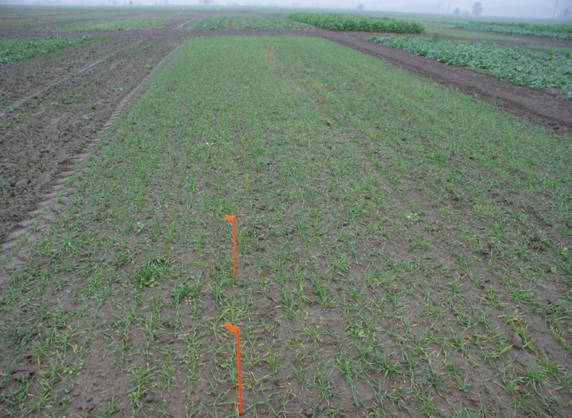
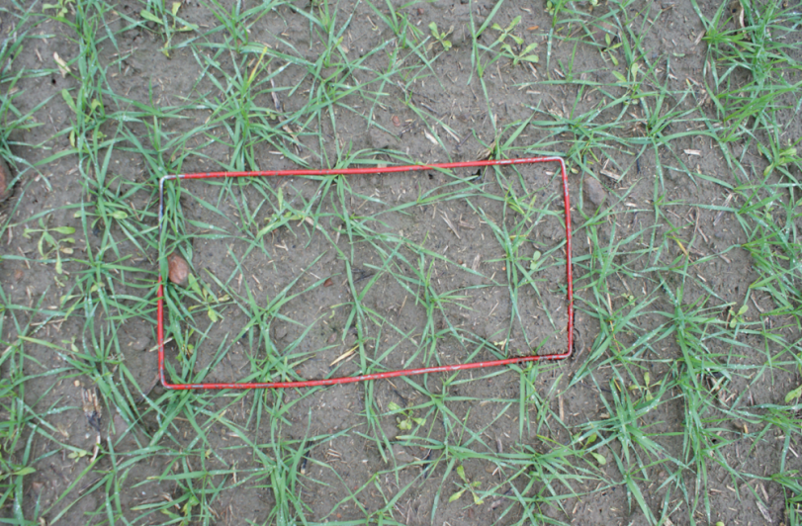
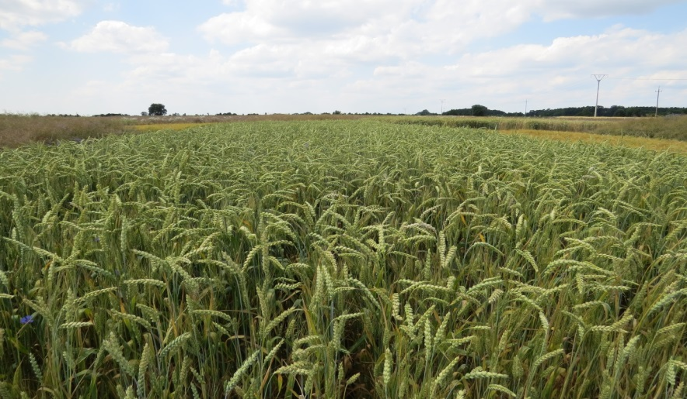
Crop diversification - effect on weeds
Winter wheat in rotation
Winter wheat in monoculture (CS) in autumn (late time od sowing - I decade of October) – mix of varieties
Weed infestation of winter wheat (crop rotation)
The different crop types in the rotation collectively promote the development of more diverse weed communities but with fewer individuals per species, thus potentially lessening the competitive effects on crop yield.
Winter wheat in advanced system (AS) – crop rotation (forecrop- winter oilseed rape) - I decade of July (mixture of two varieties in later time of sowing – I decade of October)

Slide 6
Crop diversification - Effect on diseases
Biological diversification across crops maintains and regenerates the ecosystem services that provide critical inputs—such as maintenance of soil quality, nitrogen fixation, pollination, and pest control.
Crop rotation is widely utilized for management of soil pathogens, within both small-scale and industrial agriculture. Crop rotations are widely understood to interrupt the build-up of soil pathogens, diseases vectors, and other pests while making more efficient use of available nitrogen.
Diversified cropping system practices have been shown positive effects on disease prevention and suppression and on soil quality.

Slide 7
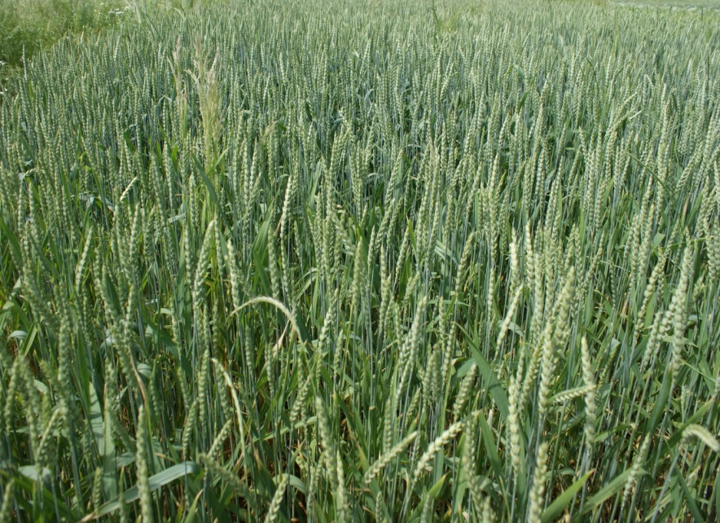

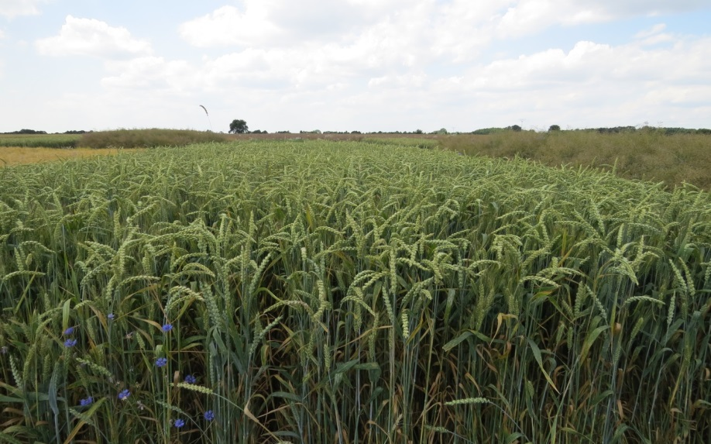
Crop diversification - Effect on diseases
Winter wheat in conventional system (monoculture)
Winter wheat in rotation
Winter wheat in advanced system (AS) – crop rotation (forecrop- winter oilseed rape) - I decade of July (mixture of two varieties in later time of sowing – I decade of October)
Winter wheat in conventional system (CS) – crop rotation (forecrop- winter wheat) - I decade of July one variety in normal time of sowing – III decade of September)
Crop rotation and mixed cropping strategies appear to be among the few viable economic alternatives to chemical control of above-ground and below-ground crop pathogens. Both mixed cropping and crop rotation practices influence many ecosystem processes and services.

Slide 8
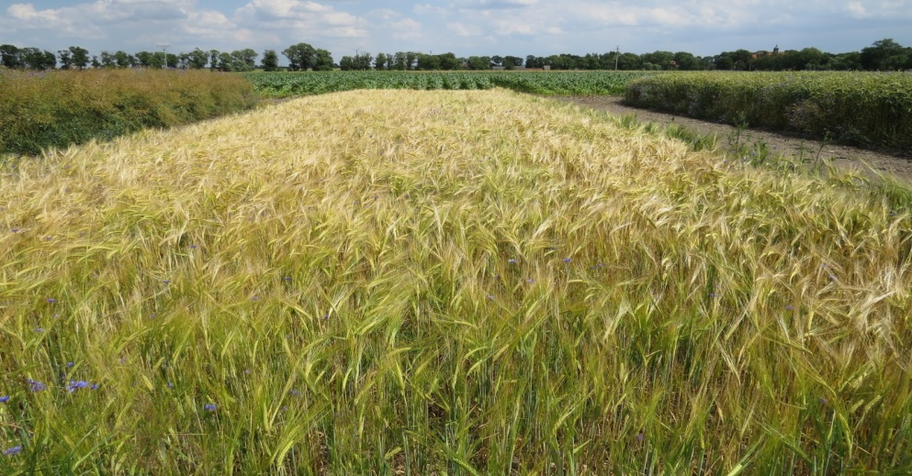
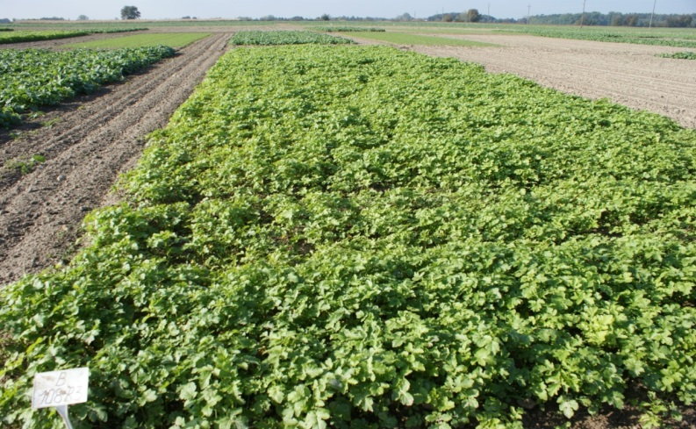
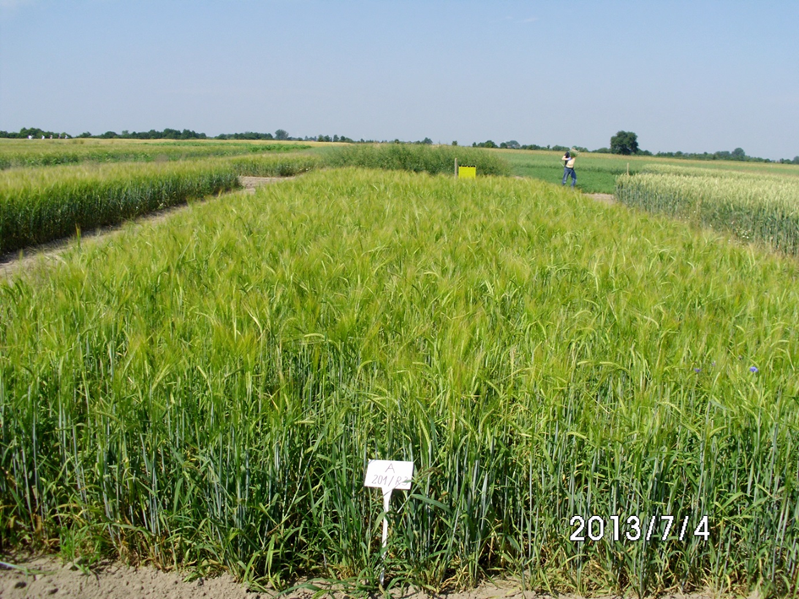
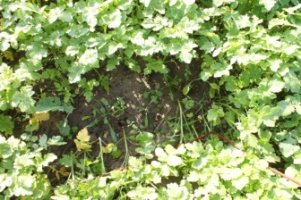
Crop diversification (catch crop) - Effect on pest and yield
The intercrop provides benefits, such as forage, food, or nitrogen fixation, and such systems can be economically superior to sole crop systems and can provide equivalent yields to conventional monoculture with herbicide.
Spring barley in intermediate system (IS)- I decade of July
WHITE MUSTARD as catch crop in AS system
Spring barley in advanced system (AS)- (white mustard in autumn as catch crop)- I decade of July (weed control only by harrowing)

Slide 9
Crop diversification - Effect on pest and yield
Crop diversification have been able to outperform conventional agriculture systems. It is possible to design many diversified cropping systems that are equally productive and that maintain or enhance the provisioning of ecosystem services and thus agroecosystem resilience and sustainability. There are substantial evidence to support significant advantages of biologically diversified cropping systems for biodiversity conservation, control of pests, weeds and diseases, soil quality maintenance, resistance and resilience of farming systems to extreme weather events, and enhanced water-holding capacity in surface soils.

Slide 10
Crop diversification
Example from experiment design in Poland (on station)

Slide 11
RESEARCH METHODOLOGY
To present practical solutions of integrated weed control strategy (IWM) has been used the results of research conducted at IOR-PIB Experimental Station Field in Winna Góra.
Experimental system:
3 system of integrated production :
Conventional reference (CS) – (standard level of agricultural technology)
intermediate IPM (IS) - (extended methods of agricultural practice in IPM)
advanced IPM (AS) - (innovation and advanced methods and tools for IPM)

Slide 12
Element | Reference (CS) | intermediate IPM (IS) | advanced IPM (AS)
Cultivation technology | ploughing | ploughing | ploughing
Crop rotation | simplified | complete (3 years) | complete (3 years)
Variety selection | V | V | V
Variety mix | -- | V | V
Sowing date | -- | V | V
Sowing density | -- | V | V
Catch crop | -- | -- | V
Pest control
No chemical method | -- | V | V
Reduced dose pf P.P.P | -- | V | V
Total used level of p.p.p. | High | Medium | low
fertilizing | Standard | Standard | Standard
Seed dressing | Standard | Standard | Standard

Slide 14
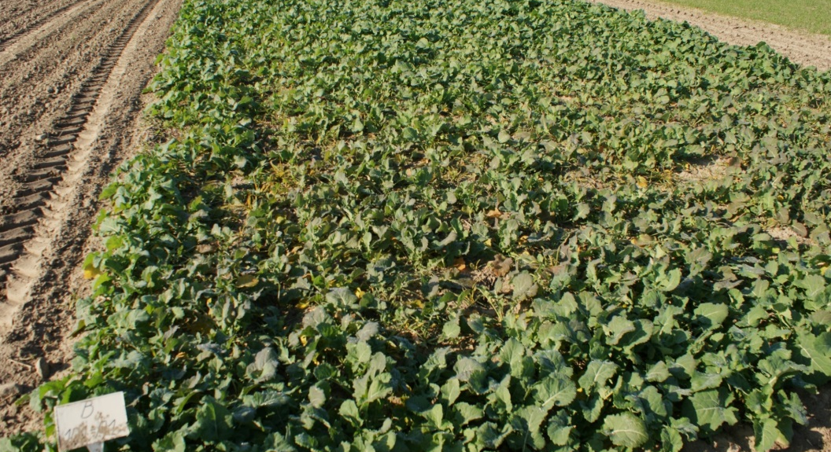
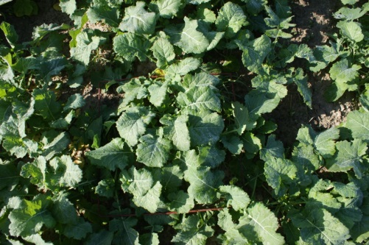
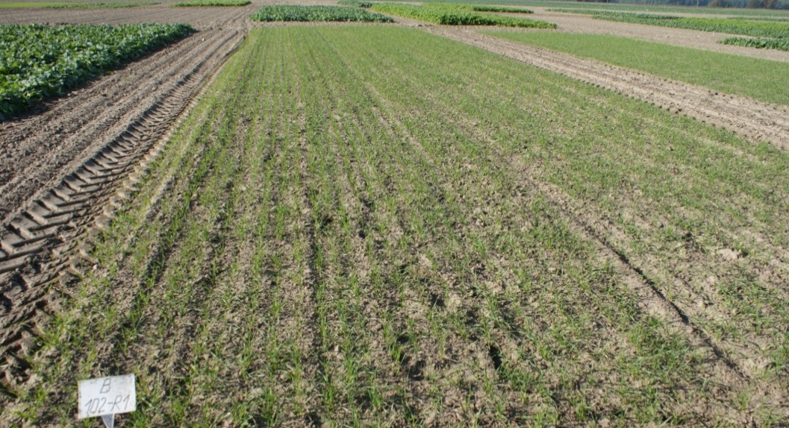
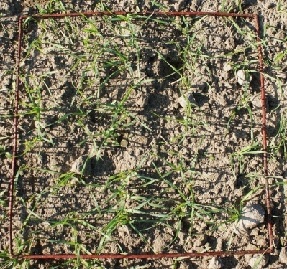
CROP ROTATION
CONVENTIONAL SYSTEM (CS)
3-year of crop rotation: winter oilseed rape (WOSR) – winter wheat (WW) – winter wheat (WW)
 |  | R1 |  | R1 |  | R1
 |  | WOSR |  | WW |  | WW (m)
 |  | R1 |  | R1 |  | R1
 |  | WW |  | WW ()m) |  | WOSR
 |  | R1 |  | R1 |  | R1
 |  | mono
 |  | WW (m) |  | WOSR |  | WW
22 m
FIRST YEAR 2012
20 m
WOSR
SECOND YEAR 2013
WW
THIRD YEAR 2014

Slide 15
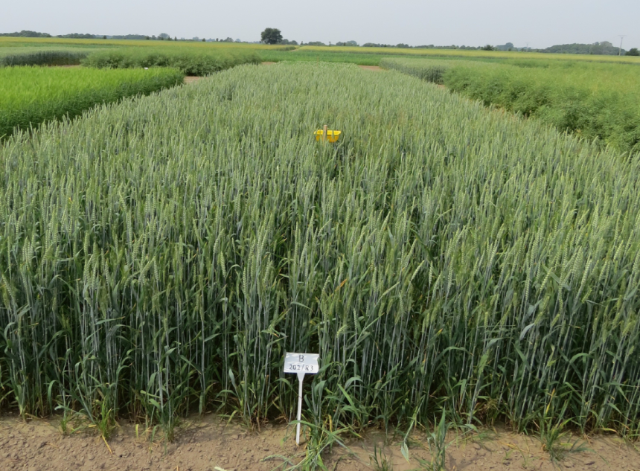
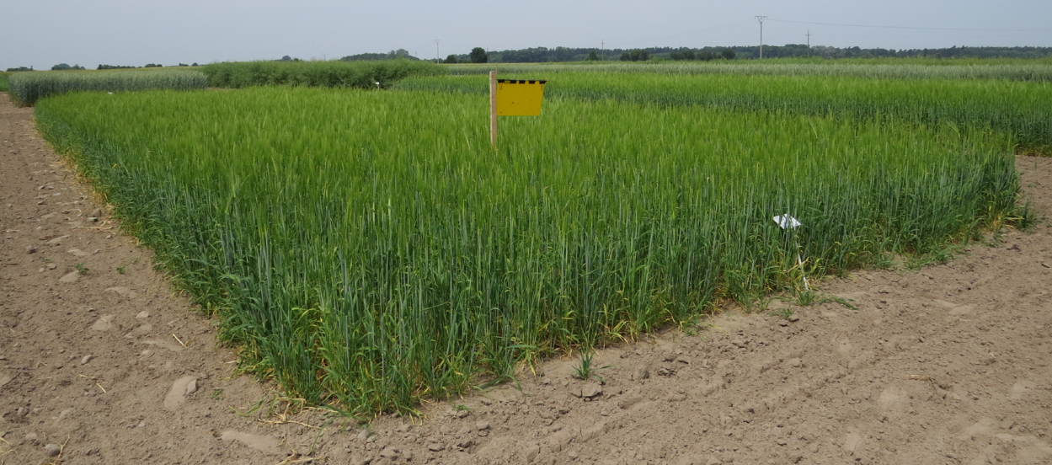
CROP ROTATION
intermediate IPM (IS)
3-year of crop rotation : winter oilseed rape (WOSR) – winter wheat (WW)– spring barley (SB)
 |  | R2 |  | R2 |  | R2
 |  | WOSR |  | WW |  | SB
 |  | R2 |  | R2 |  | R2
 |  | WW |  | SB |  | WOSR
 |  | R2 |  | R2 |  | R2
 |  | SB |  | WOSR |  | WW
FIRST YEAR 2012
SPRING BARLEY
SECOND YEAR 2013
THIRD YEAR 2014

Slide 16


CROP ROTATION
advanced IPM system (AS)
3-year of crop rotation : winter oilseed rape (WOSR) – winter wheat + catch crop (WW+ cc) – spring barley (SB)
 |  | R3 |  | R3 |  | R3
 |  | WOSR |  | WW + cc |  | SB
 |  | R3 |  | R3 |  | R3
 |  | WW + cc |  | SB |  | WOSR
 |  | R3 |  | R3 |  | R3
 |  | SB |  | WOSR |  | WW + cc
FIRST YEAR 2012
SECOND YEAR 2013
WHITE MUSTARD
THIRD YEAR 2014

Slide 17
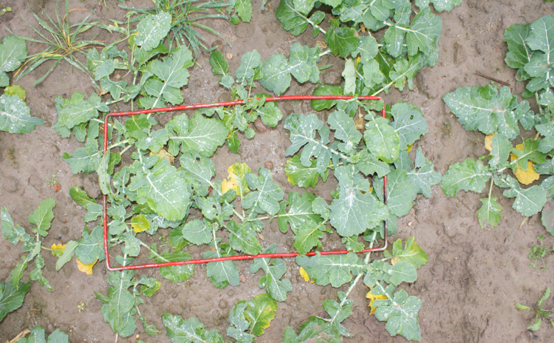
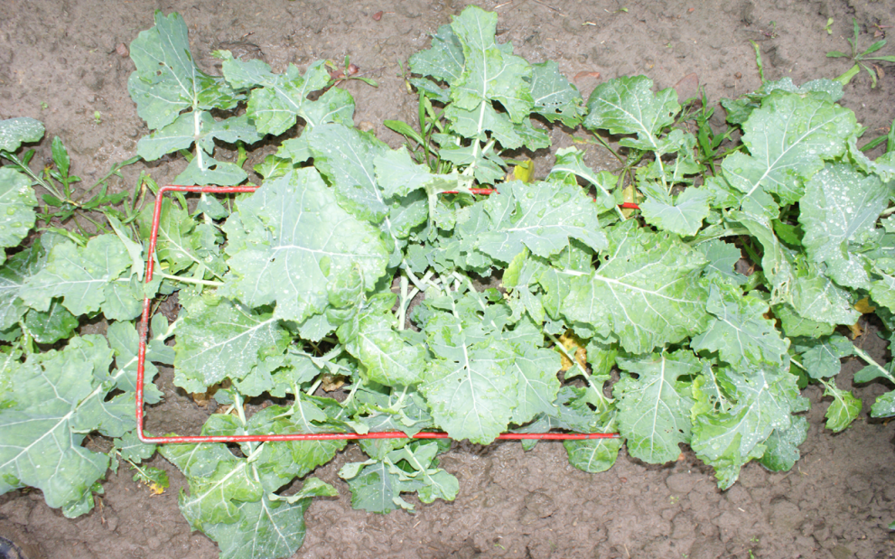
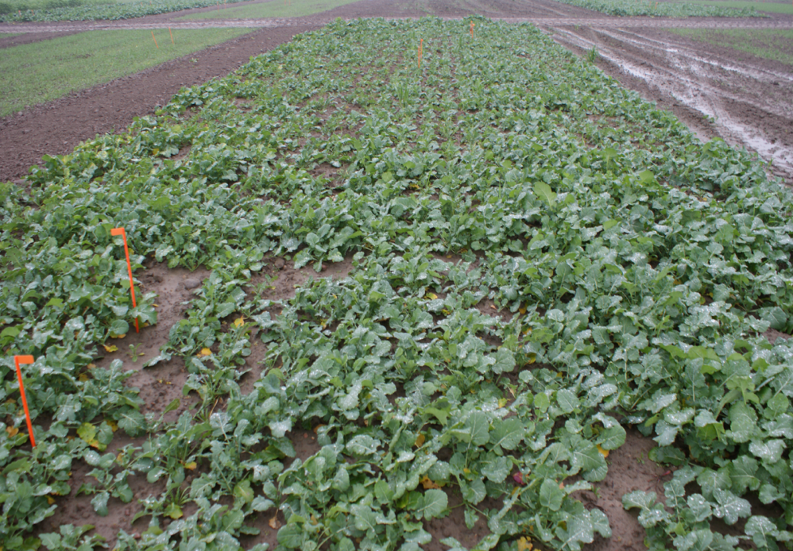
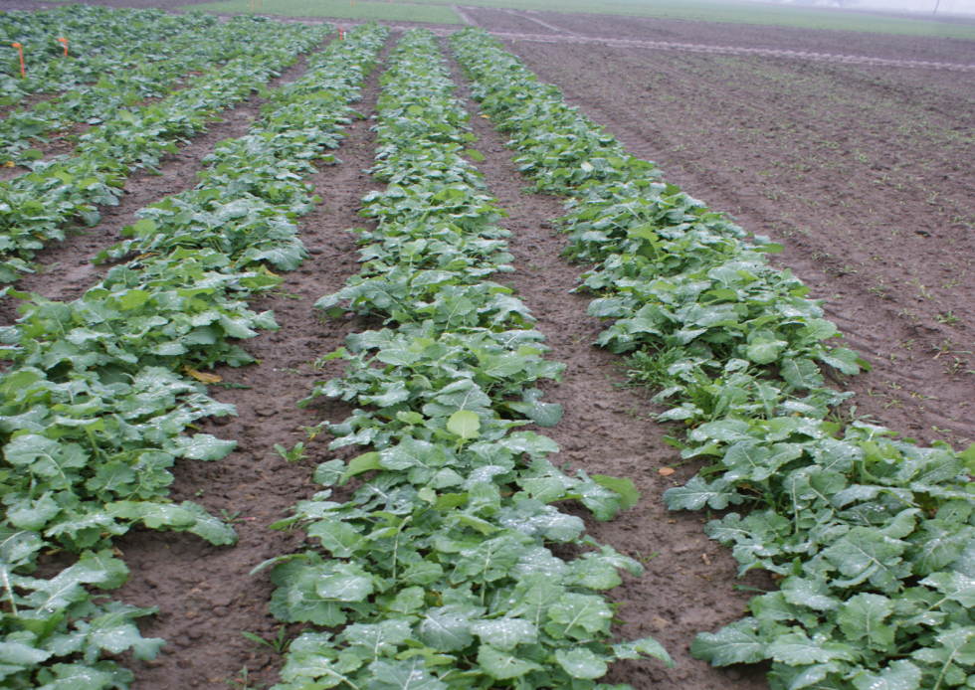
Winter oilseed rape
z. 20.11.2013r.
Conventional system (CS)
Advanced system IPM (AS)

