Slide 1
Inter-row cultivation for mechanical weed control in winter oilseed rape
WP2, Innovative IPM solutions for winter wheat based rotations

Slide 2
Motivations for employing mechanical weed control
Non-chemical weed management tactics are important for implementing the intentions of IPM crop protection programmes in arable crops
Mechanical weed control methods lead to less reliance on herbicides and reduce adverse side-effects from herbicide use
Inter-row cultivation has shown promise for non-chemical weed control in winter oilseed rape

Slide 3
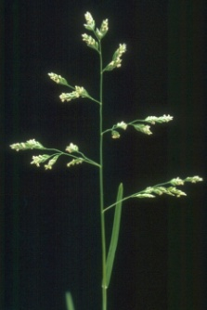
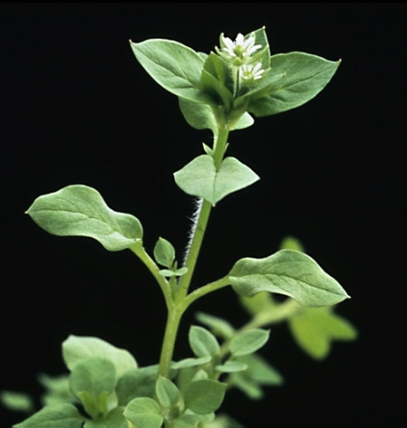
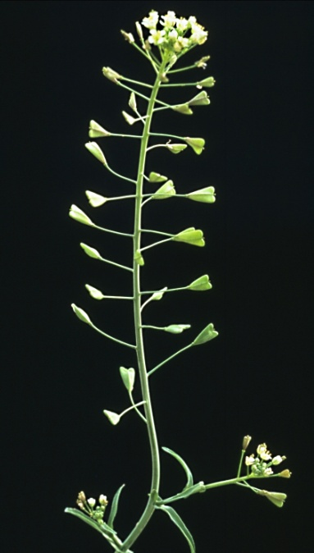
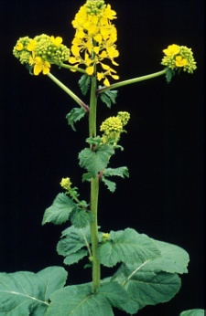
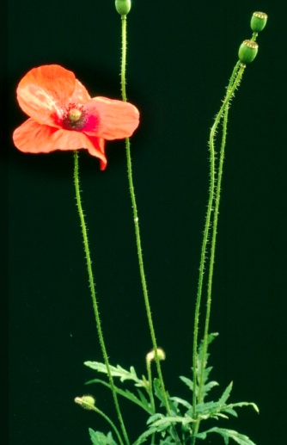
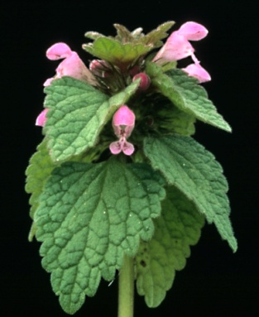
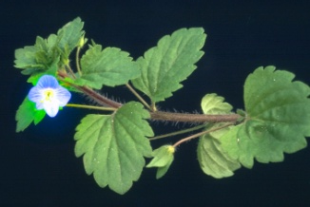
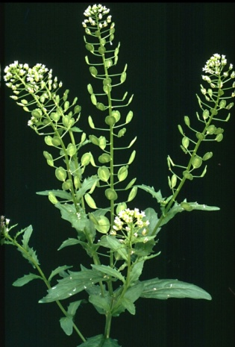
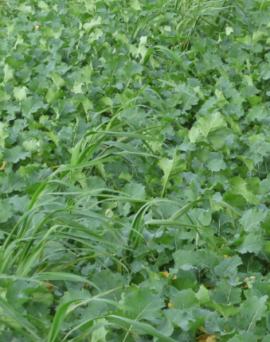
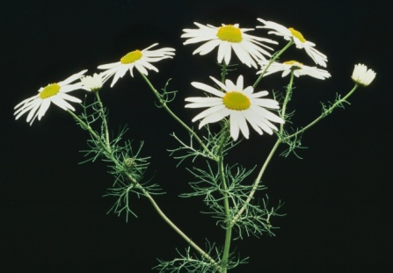
Principal weed species causing problems in winter oilseed rape in Northern Europe
Poa annua
Sinapis arvensis
Stellaria media
Capsella bursa-pastoris
Papaver rhoeas
Veronica persica
Lamium purpureum
Volunteer cereals
Tripleurospermum perforatum
Thlaspi arvense

Slide 4
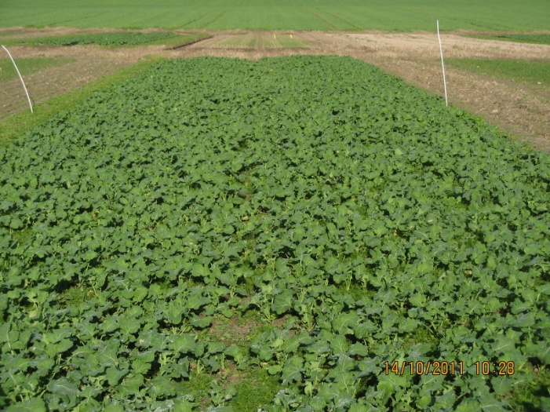
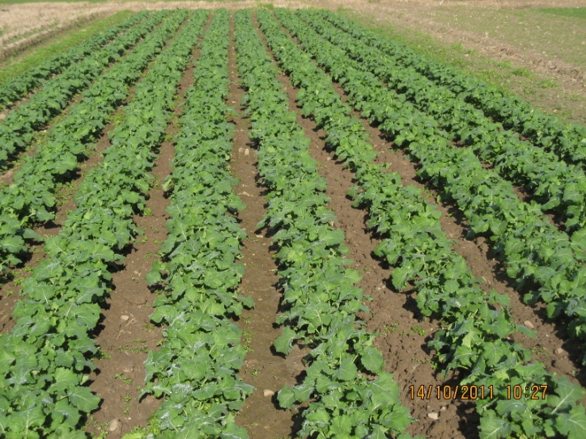
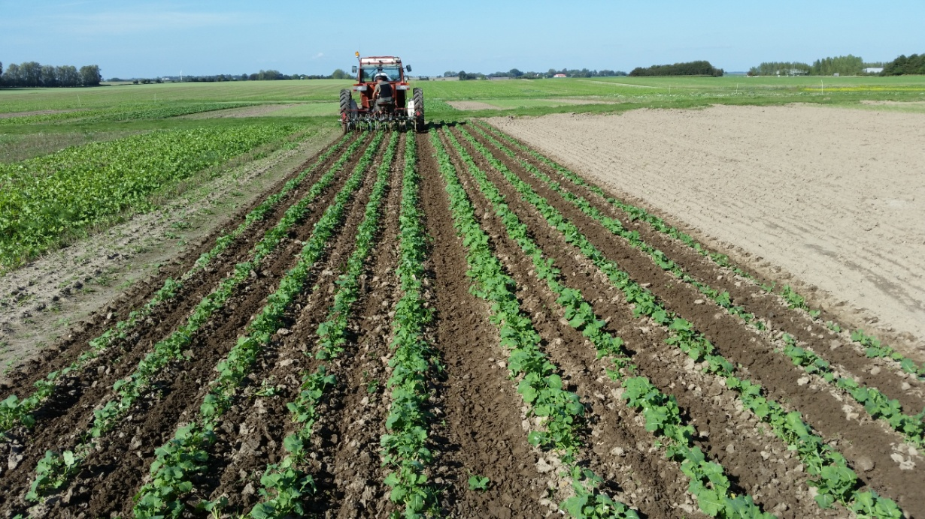
Inter-row cultivation requires increased row spacing, preferably 50 cm
Normal row spacing 12.5 cm. (14 October 2011)
Increased row spacing 50 cm. (14 October 2011)
Inter-row hoeing in April 2014

Slide 5
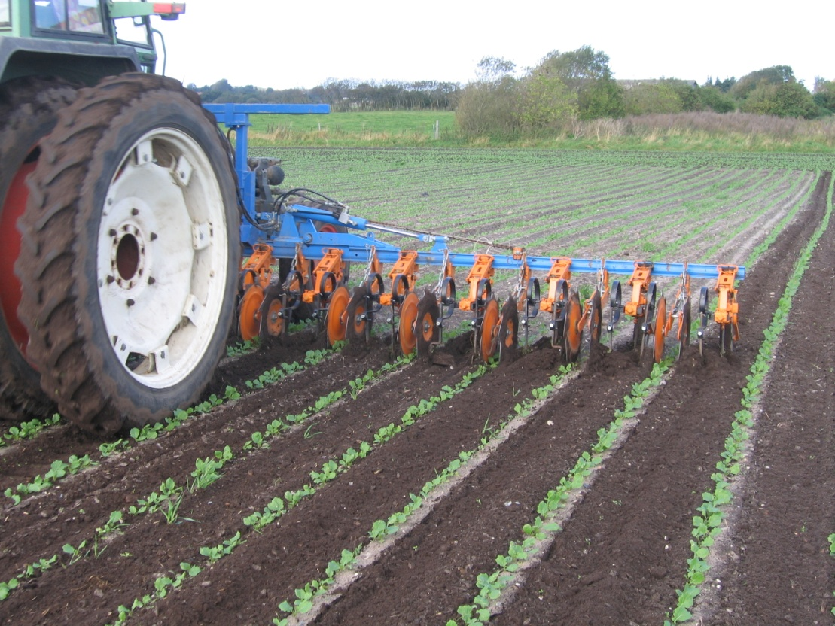
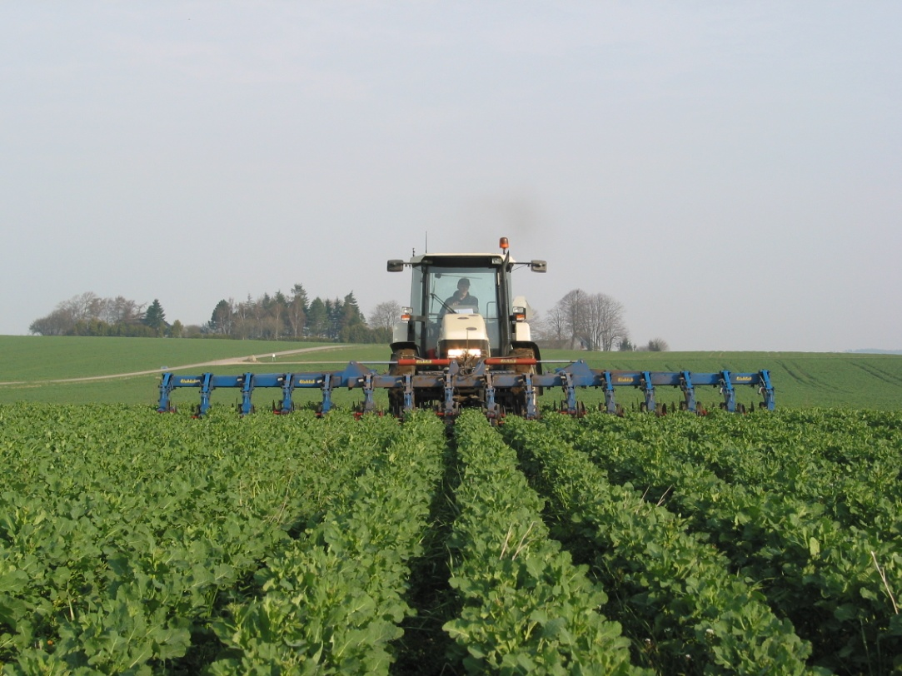

The implement for inter-row cultivation
Inter-row hoeing in Septemper at an early crop growth stage (oilseed rape with 2-3 true leaves)
Inter-row hoeing in late April using a front-mounted hoe for manual steering
Videoclip of inter-row hoeing in September in the PURE-experiment at Flakkebjerg

Slide 6
Links to examples of inter-row hoes relevant for inter-row cultivation in winter oilseed rape
Inter-row cultivators with goosefoot shares (blades) including examples of camera-based automatic steering systems:
http://www.kongskilde.com/Agriculture/Soil/Weed%20Control
http://www.einboeck.at/index.php?option=com_content&view=article&id=1591&Itemid=665&lang=en
http://garford.com/products_robocrop.html
http://www.steketee.com/category/Mechanische-onkruidbestrijding

Slide 7
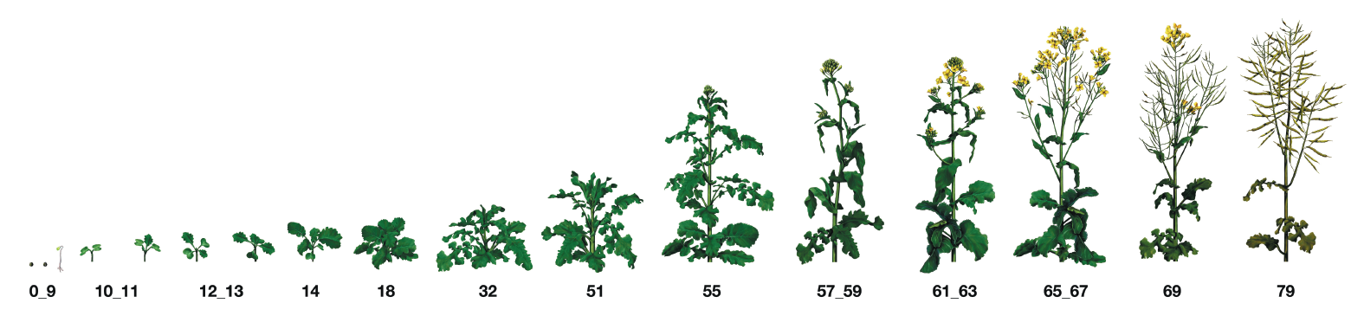
Weeding strategy for inter-row cultivation in winter oilseed rape
Early autumn, first pass at the 2-4 true leaves stage - mandatory. Use protective discs to avoid covering the crop with soil
Mid-autumn, second pass if necessary. Protective discs may be removed to allow for slight ridging of the crop to suppress intra-row weeds
Early spring, a third pass might be necessary in case of high weed pressure and mild winters. No need for protective discs

Slide 8
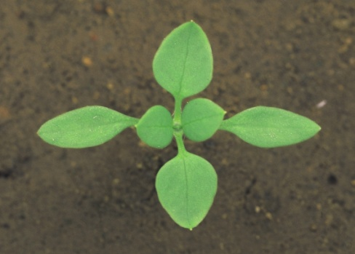
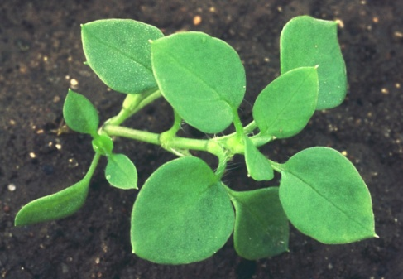
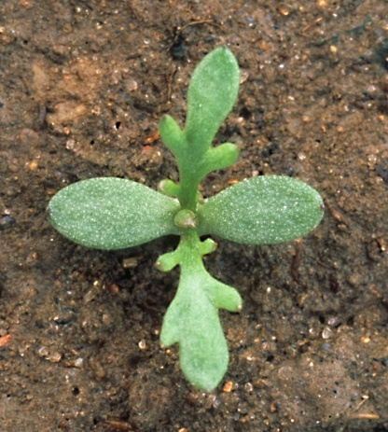
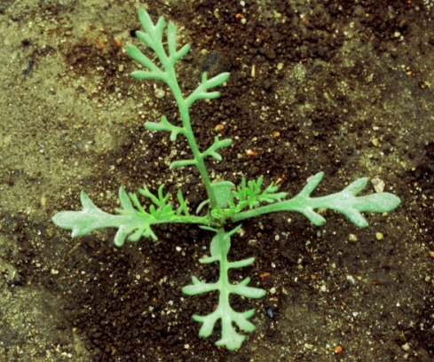
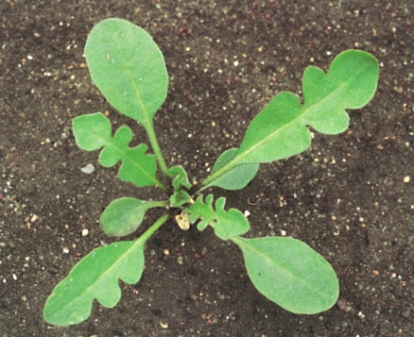
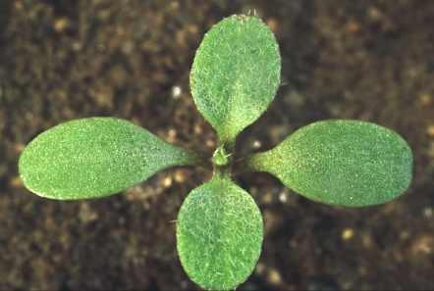
Vulnerability of weeds to hoeing at different weed growth stages
Easy to control, very limited regrowth
Regrowth may take place under wet weather conditions after treatment
Stellaria media
Tripleurospermum perforatum
Capsella bursa-pastoris

Slide 9
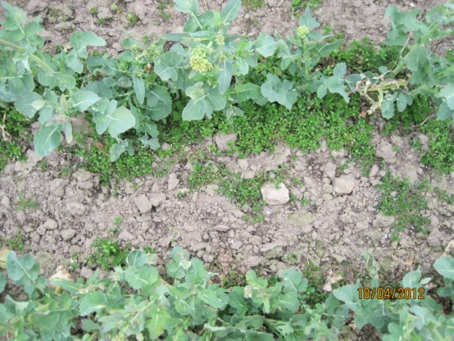
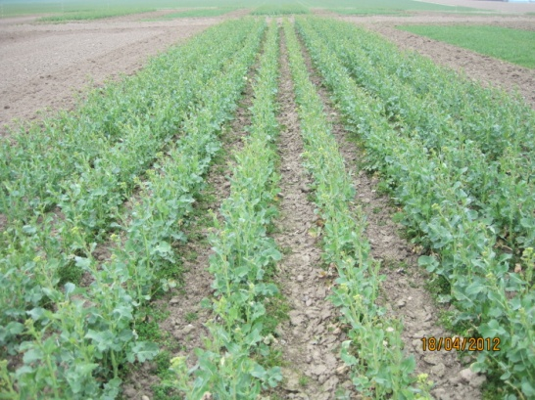
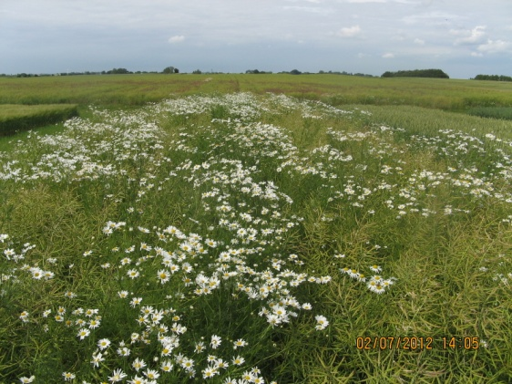
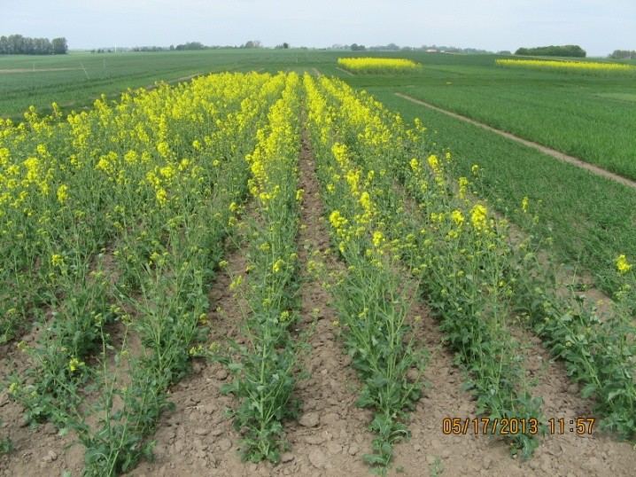
High pressure from competitive intra-row weeds may require chemical weed control
Weedy crop rows can result in yield losses and considrable weed seed shedding – especially volunteer cereals,Tripleurospermum perforatum and Papaver rhoeas can be problematic
Use band-spraying for the control of intra-row weeds in order to minimise herbicide input
Nice and clean crop rows

Slide 10
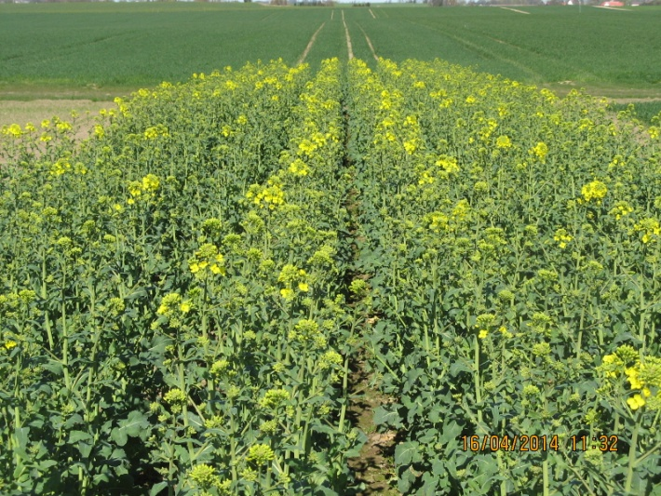
Conclusion
Inter-row cultivation for mechanical weed control is an important IPM-tool for winter oilseed rape and can in many case provide sufficient weed control. Supplementary intra-row control with herbicides may be required where competitive weeds and volounteers with an erect growth habit occur in high numbers
Inter-row cultivated oilseed rape on 16 April 2014 – a perfect crop!

